Slide 1
The slicers
The slicers

Slide 2
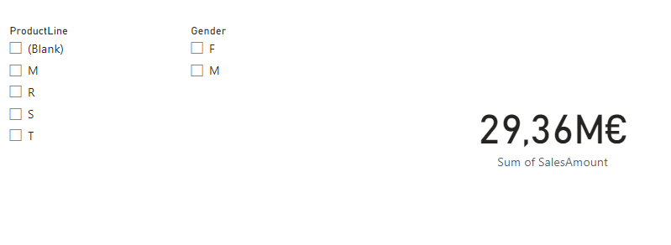
The slicers
Add two Slicer visualizations to the scene and a map visual
Configure the first slicer to display ProductLine from the DimProduct table
Configure the second slicer to display gender from the DimCustomer table
Configure the map visual to display the sales amount from FactInternetSales painting
Try selecting different options from the slicers and observe the impact on the

Slide 3
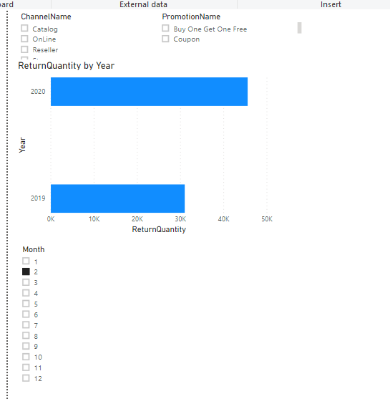
The slicers
Note that the last field East digital .

Slide 4
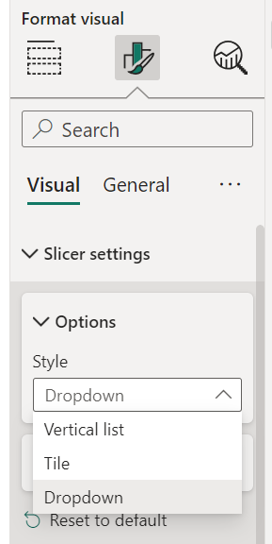
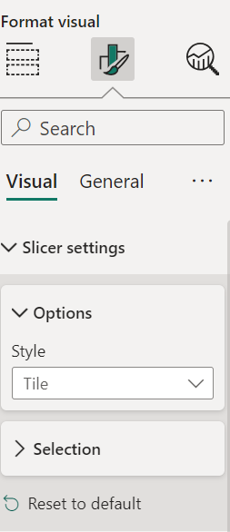
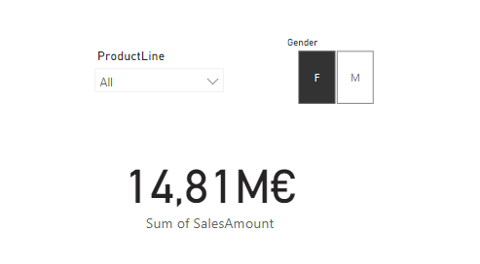
The slicers
Change the visual behaviors of both slicers to Dropdown and Tile respectively for ProductLine and Gender using the Format section , then Style
1
1
2
2
3
3

Slide 5
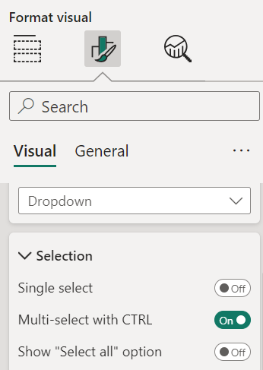
The slicers
Now try changing the selection behavior always from the Format section then Selection

Slide 6
Thank you
Thank you

